Slide 1
“KiP” distribution optimization
Advanced Data Analytics - Analytics and Optimization, Case study
Anastasia Merezhina & Milica Mišković
Belgrade, March 2024

Slide 2
Table of Contents
Problem description
Short-term Distribution Optimization
Demand Prediction
Long-term Distribution Optimization

Slide 3
Current distribution setup
Wholesale company KiP is faced with suboptimal distribution due to changing demand trends - as the demand rises, in some Regions the Distribution centers are short on goods.
6 Distribution centers and 335 Retailers - Vojvodina (85), Belgrade (55), Sumadia, Western Serbia (50 each), East&South Serbia (65) and Kosovo&Metohia (30)
Distributing pallets of goods, 10 per truck, at 0.8 EUR/km

Slide 4
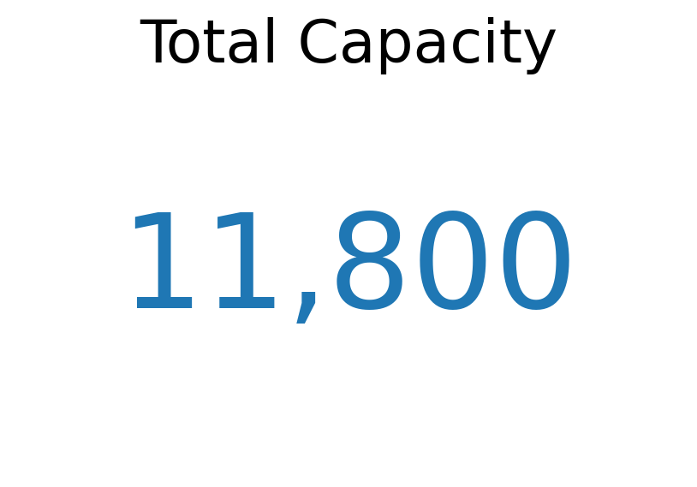
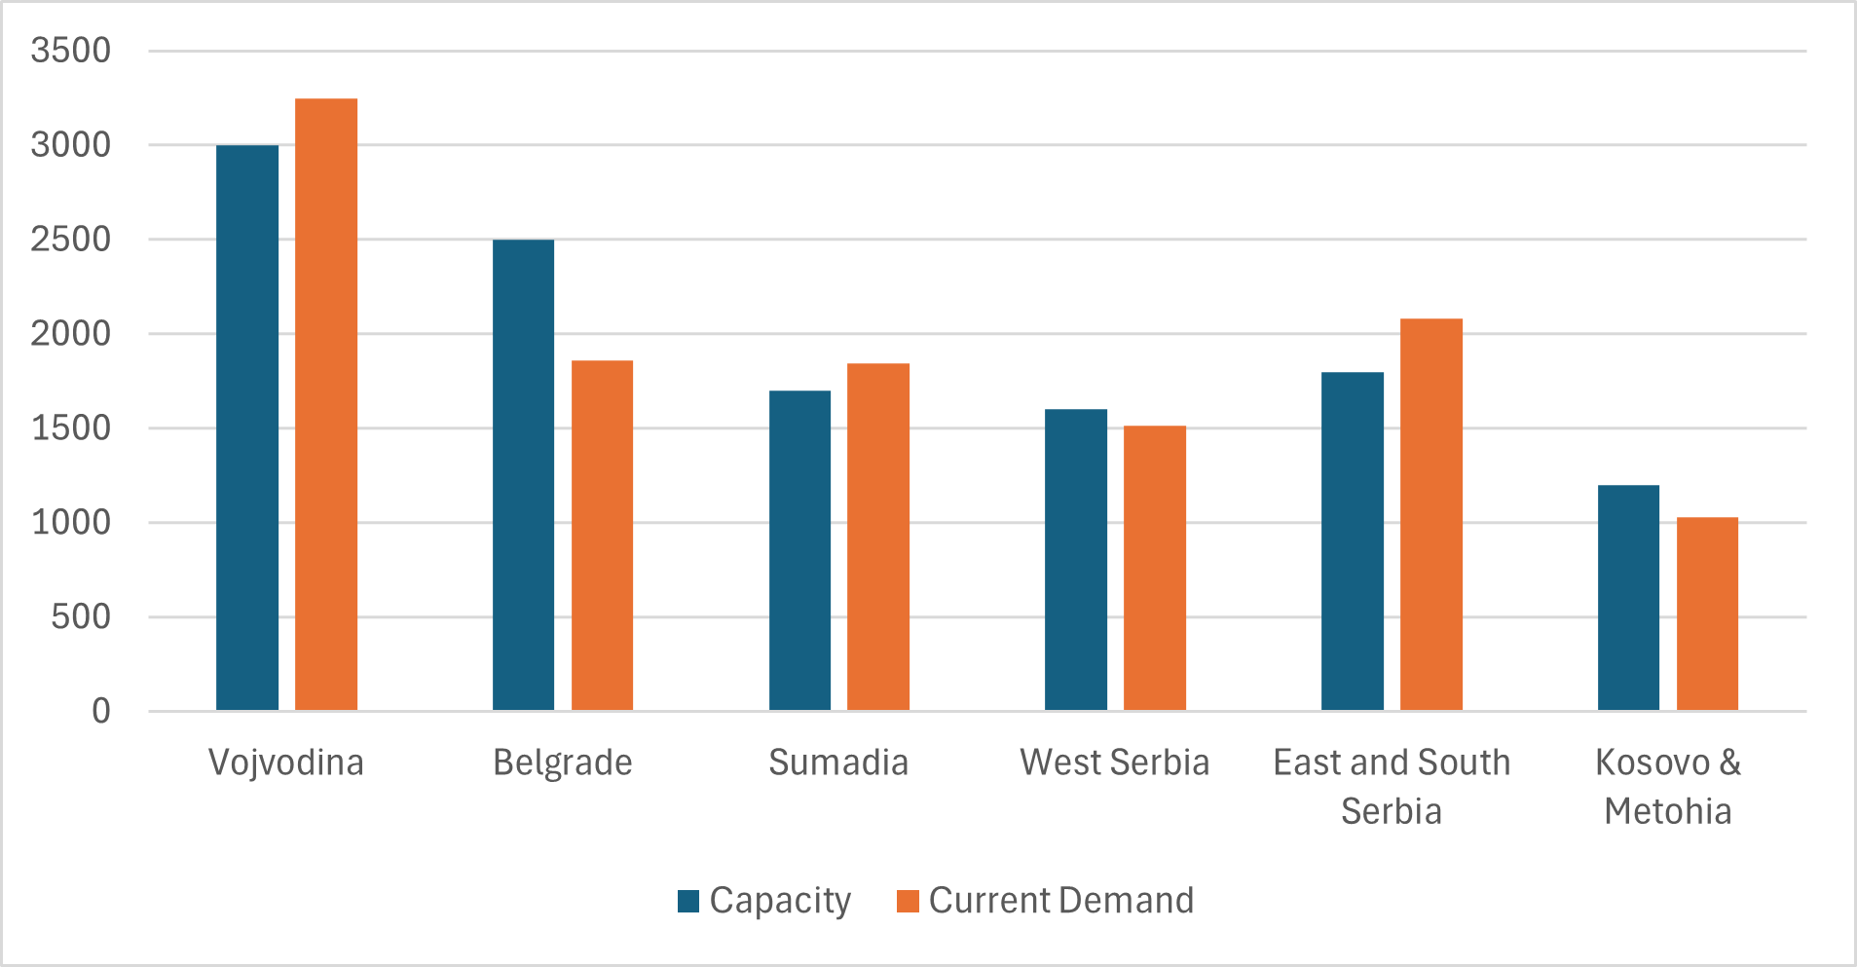
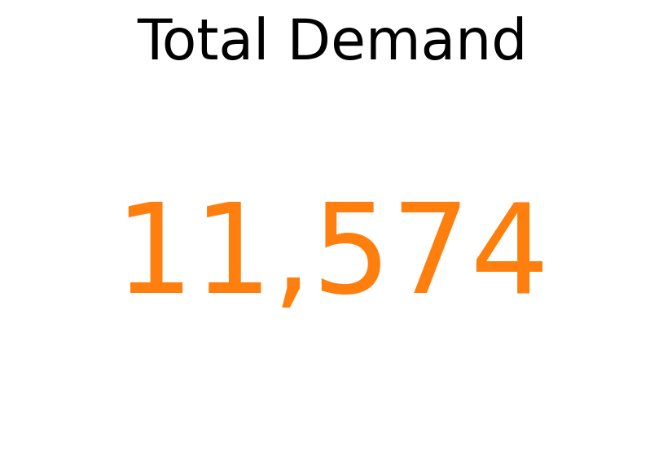
Capacity vs Demand

Slide 5
Short term problem description and assumptions
Solution to the distribution issues in the short-term - reallocate Retailers to balance out demand and distribution centers’ capacity.
Assumptions:
A Retailer can be supplied from one and only one Center
A truck visits one Retailer per trip, so to supply it, it has to go there
w = ceiling( demand / truck capacity ) times
(if a Retailer demands 32 pallets, truck with a capacity of 10, will go there 4 times)
The goal is to minimize the distribution costs, while satisfying each Retailer’s demand, and staying within each Center’s capacity.

Slide 6
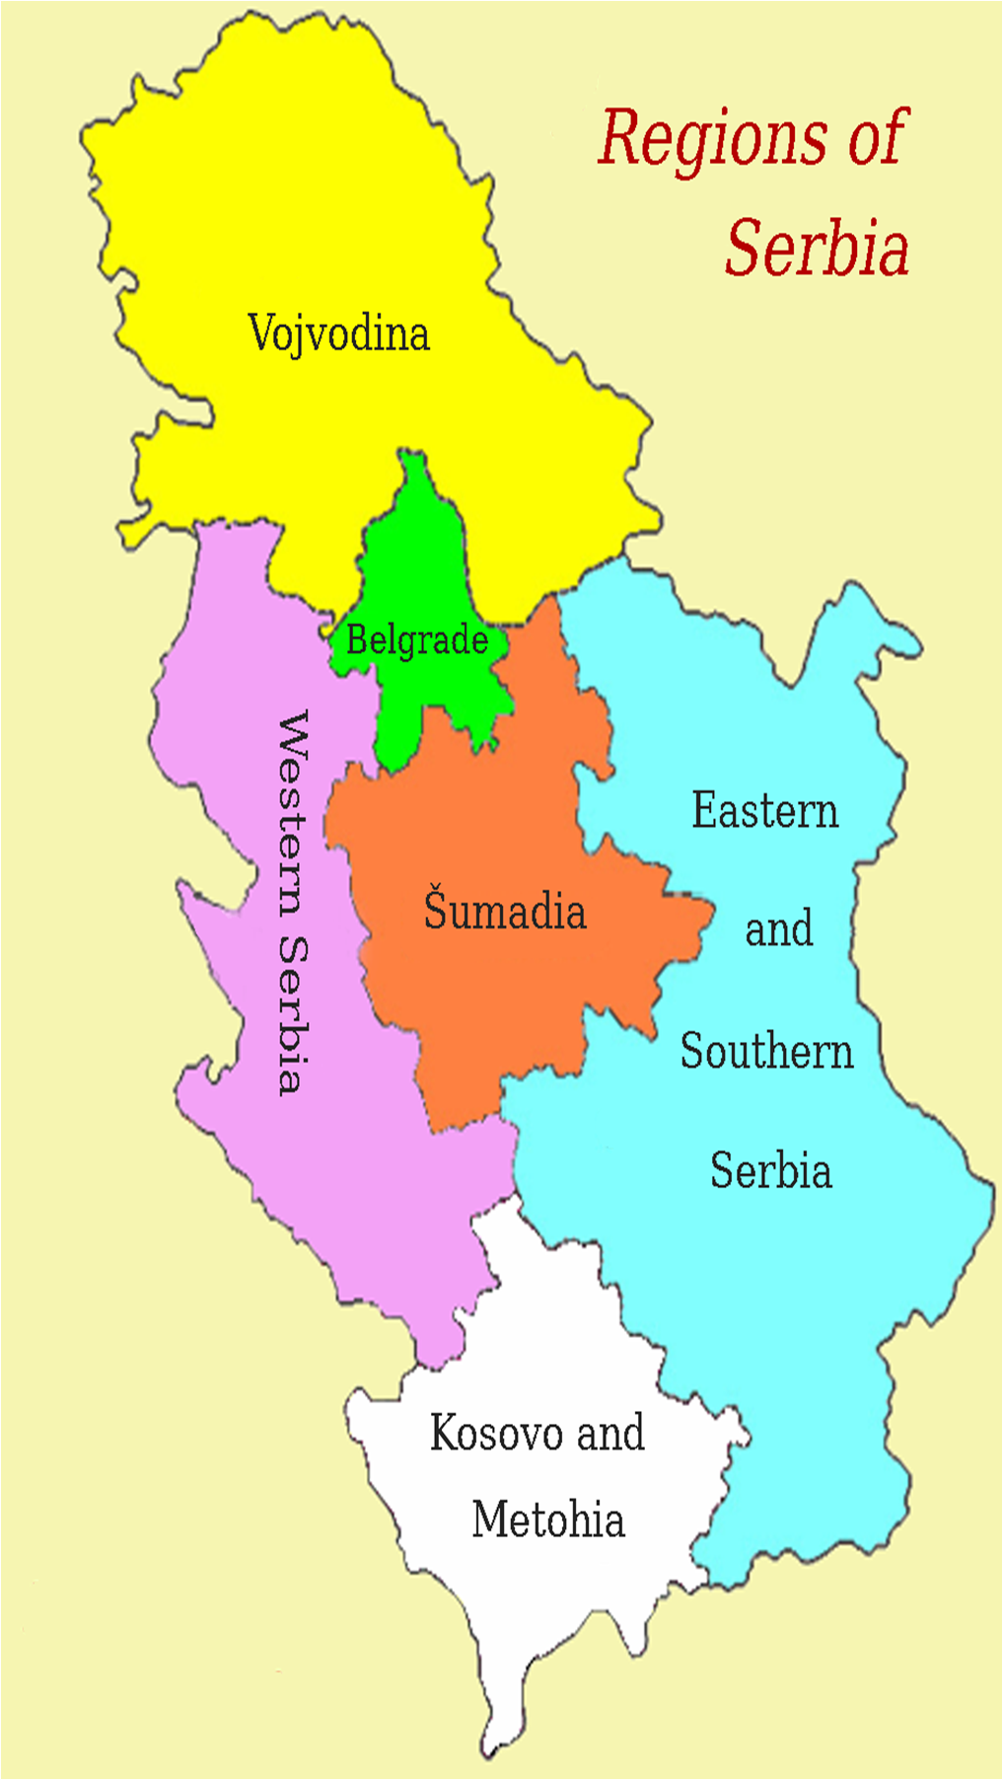
Reallocation results
Shortage in Vojvodina causes Retailers to shift to other Centers
Many Retailers reallocated to Belgrade because it has a large surplus
Lots of shuffling around Sumadia due to its central position
Little disturbance otherwise
rw17
rb08 rb46
19
rs01 rs24
rs33
rk29
12
rv02 rv66
rw08 rw11 rw32 rw35 rw48
re04 re09 re38 re41 re59
rb24 rb35
13
rs13 rs25
rs31 rs49
16
6

Slide 7
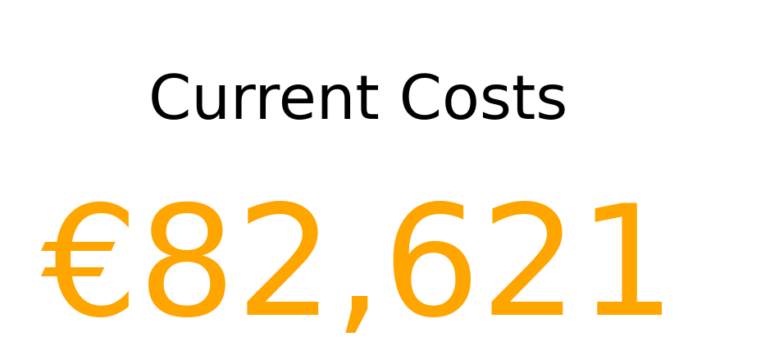
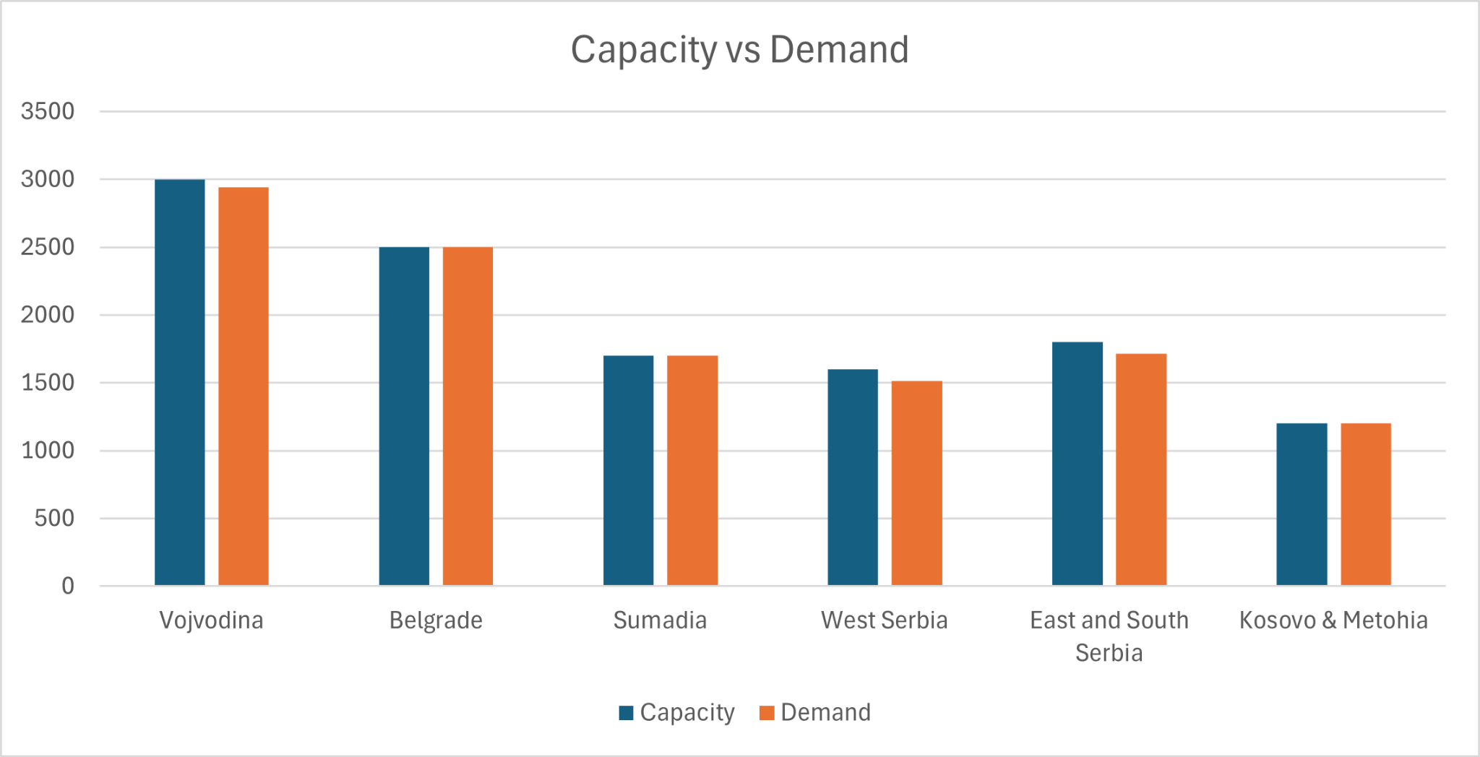
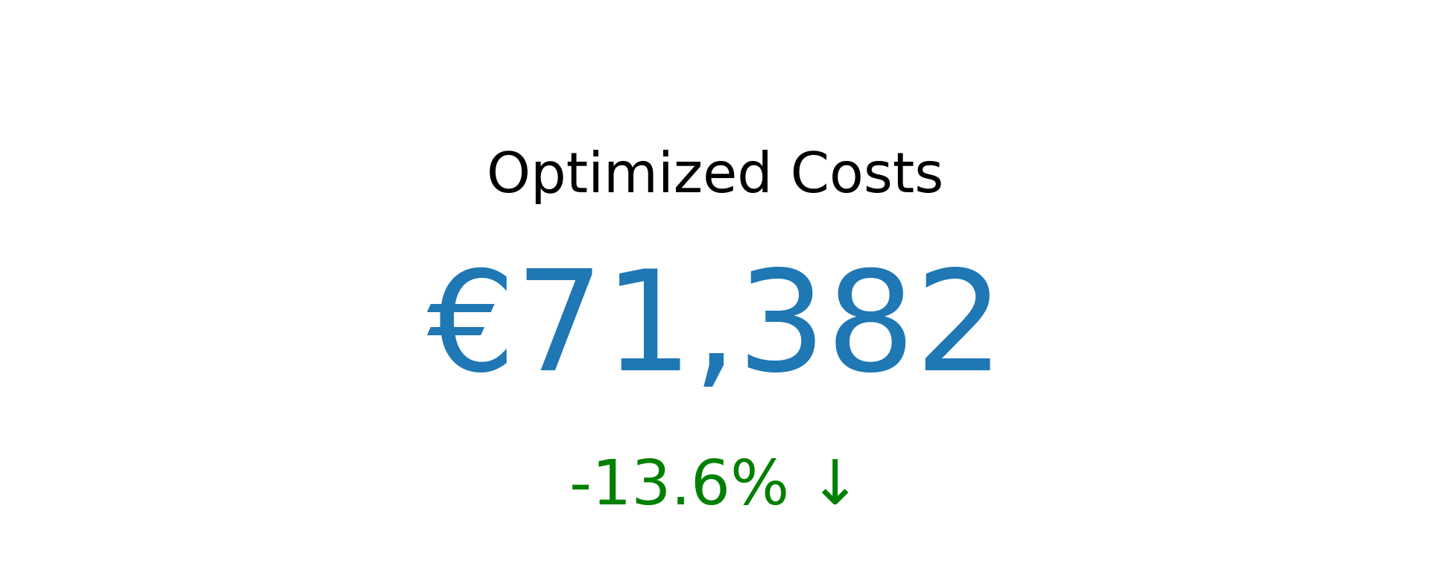
Optimization results

Slide 8
Data Preparation Steps for Prediction
Two missing values were replaced with median values
Outliers were primarily identified as human errors in data entries and were easily corrected (e.g., 5164 -> 1164)

Slide 9
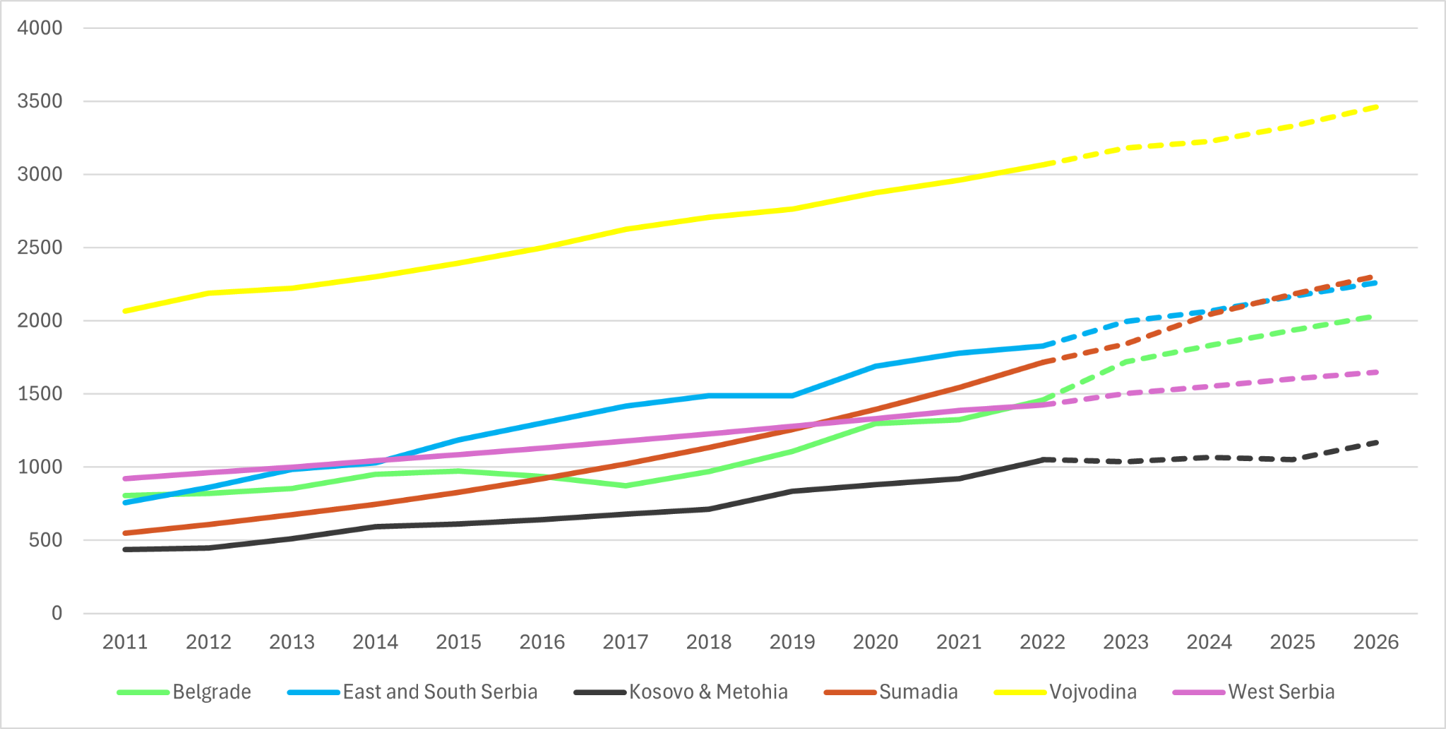
Average Monthly Demand per Region

Slide 10
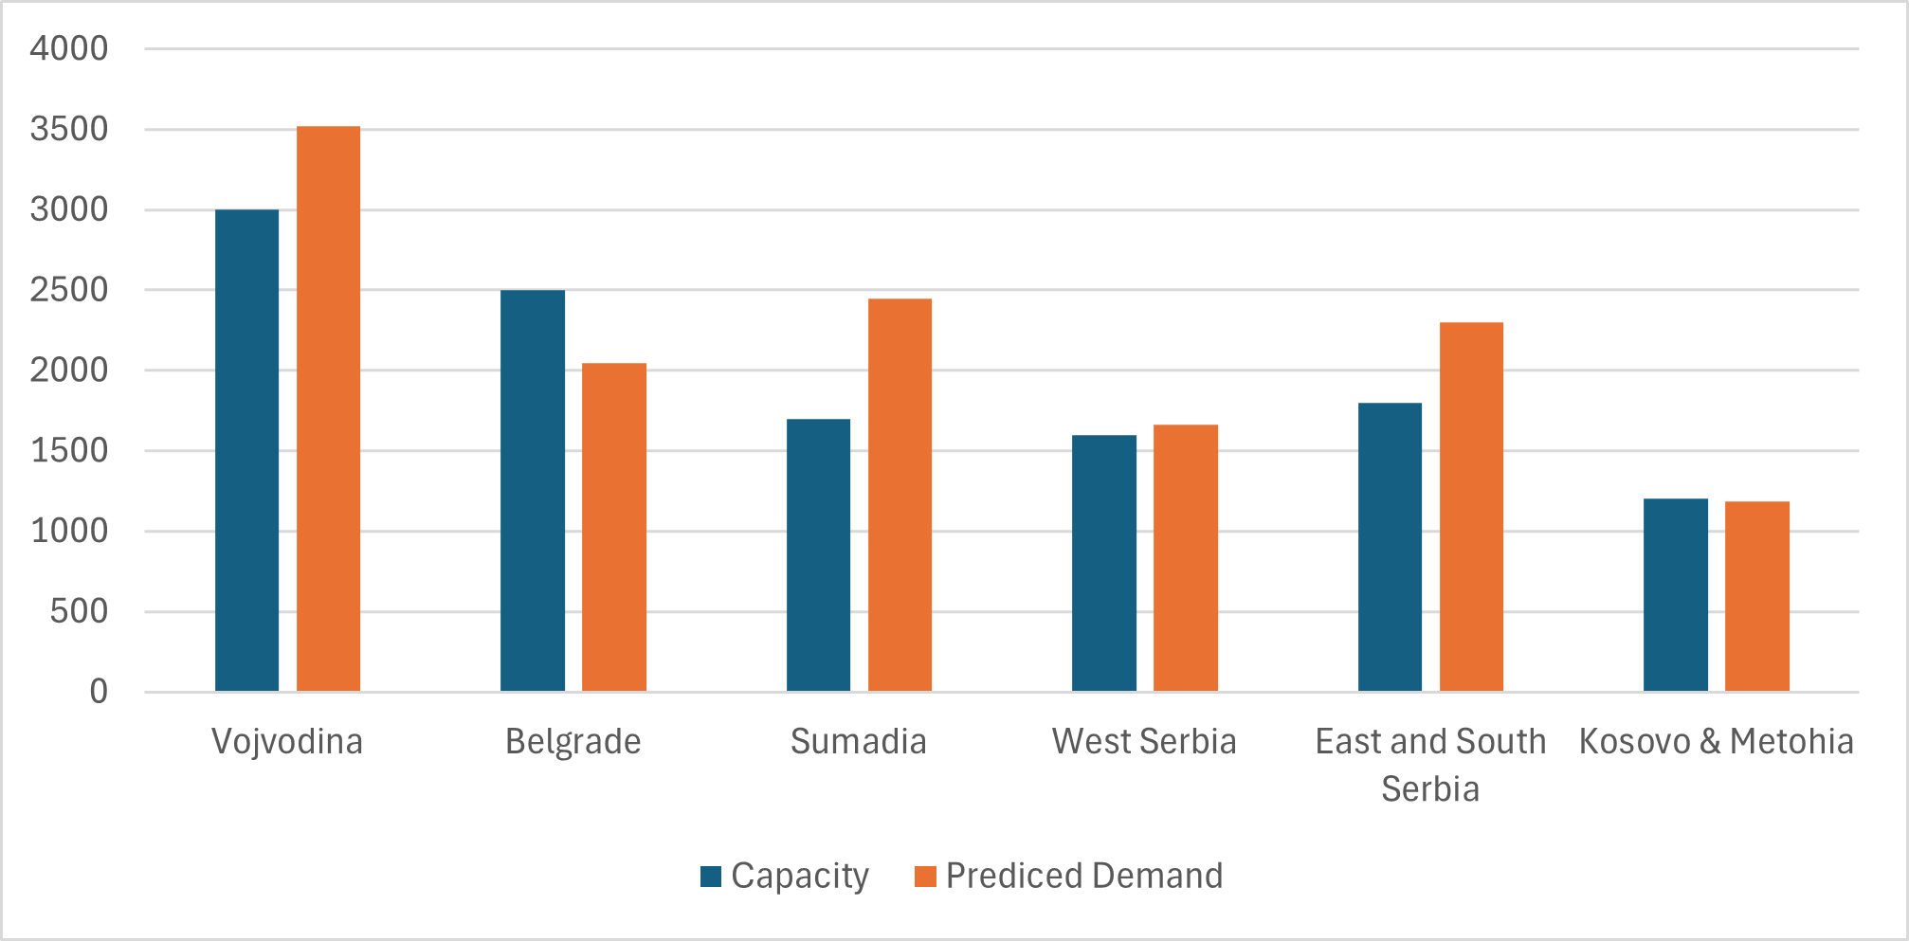
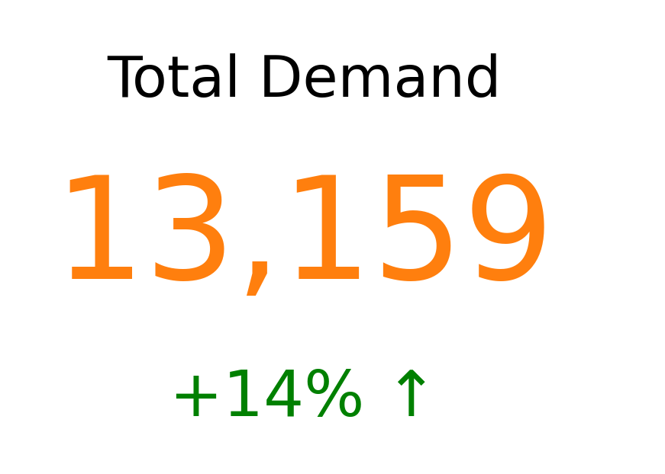
Prediction

Slide 11
Long term problem and assumptions
Based on predicted demand, KiP will have a shortage of over 1350 units monthly - new Distribution Centers are necessary.
Our assumption for the longer term optimization, in addition to previously established ones:
We are optimizing for the moment in three years time, not the time between now and then; we are not looking to gradually add new Centers as need arises.
The goal is again to minimize distribution costs but this time they include renting new locations.

Slide 12
Reallocation results
New Distribution Centers rented in Sumadia and West
Many Retailers allocated from Vojvodina and East to other Regions due to large shortage in the two areas
Most shuffling in the central Serba to achieve minimal costs
1
13
9
11
3
4
3
16
12
ndcs1
ndcw1
ndcw2
2
rk03 rk05 rk28
rs10 rs24
6
1
rs03 rs05 rs06 rs11 rs15 rs16 rs19 rs22 rs23 rs26 rs29 rs30 rs32 rs35 rs38 rs43
rw04 rw07 rw09 rw12 rw18 rw21 rw22 rw25 rw41
rw14 rw37
rw02 rw03 rw05 rw08 rw11 rw17 rw32 rw35 rw48 rw49

Slide 13
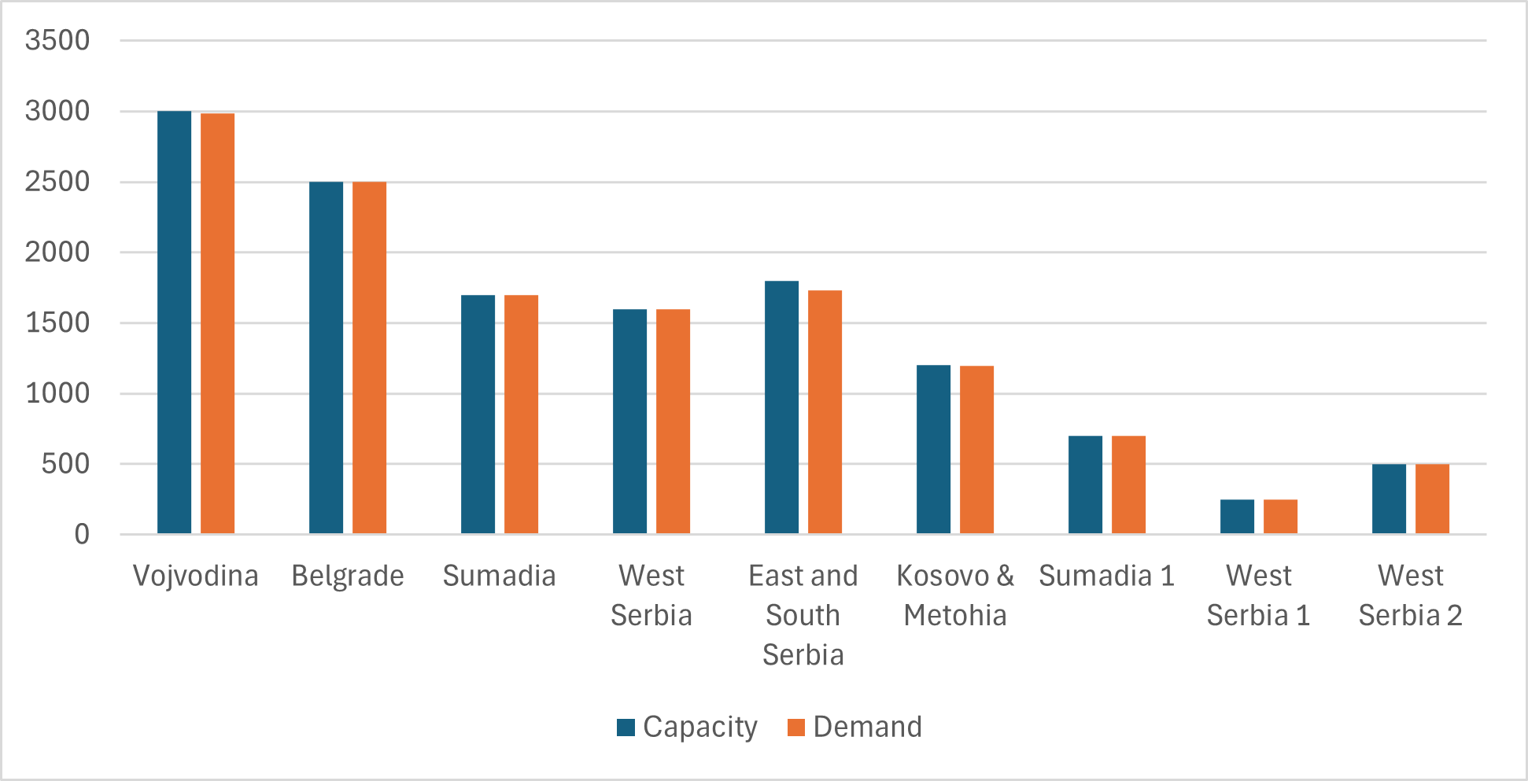
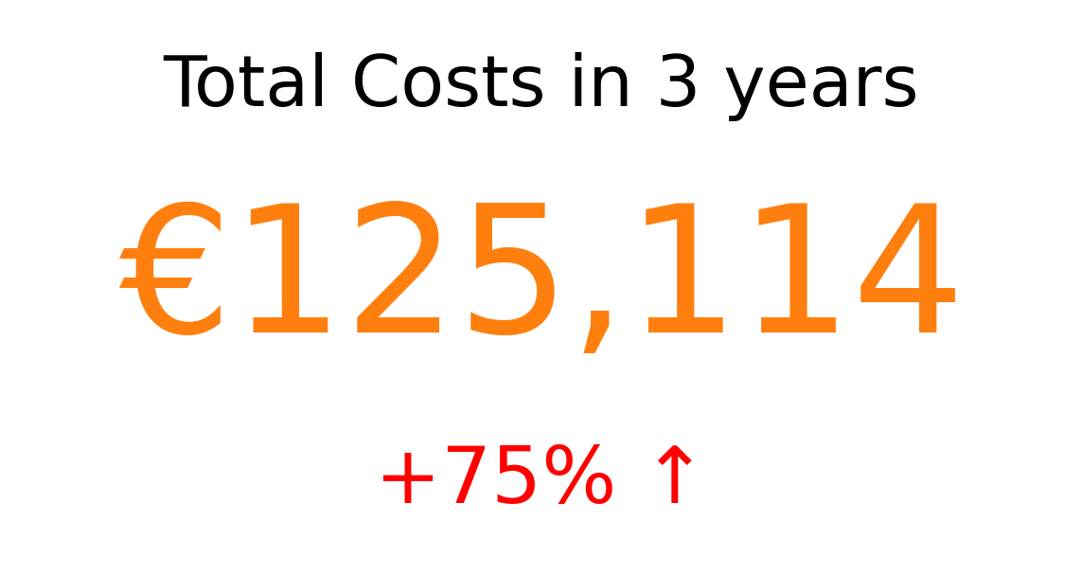
Long term solution

Slide 14
Conclusion
The current expenses have been reduced by 14%
Three new centers rented, out of ten available
Surplus of around 100 pallets, space for 2800 more left available for rent
Will the Retailers remain the same? Will truck capacity?
We are offering a model for optimizing distribution which includes renting new Distribution centers, which should be applicable as long as basic assumptions hold
Future can not be predicted 100% accurately, but we can be prepared for it nevertheless!

Slide 15
Thank you for your attention!
Q & A

Slide 16
Additional Information
Mathematical Model – Short-term
Short-term Retailers Reallocation
Prediction
Mathematical Model – Long-term
Choice of New Locations
Long-term Retailers Reallocation

Slide 17


Short term Optimization - Mathematical Model
Subject to:
Where:
R – a set of Retailers – 335 total
D_{i} – demand of i-th Retailer
DC – a set of Distribution Centers – 6, one per Region
C_{j} – capacity of j-th Distribution Center
x_{ij} - the binary variable such that x_{ij} = 1 iff i-th Retailer is supplied by j-th Distribution Center, and 0 otherwise
l_{ij} – the cost of supplying i-th Retailer from j-th Distribution Center, calculated as:
Where:
cost – the unit cost of trip, given in the problem description – 0,8 EUR
tC – truck capacity, given in the problem description – 10 pallets, therefore
ceiling(D_{i} / tC) – is the formula for calculating the number of trips a truck has to make to satisfy i-th Retailer’s demand,
2 – serves to account for the truck going to a Retailer and back.
k – the weight for the Minkowski distance function, given in the problem description – 1.66
xDC_{j} and yDC_{j} – coordinates of j-th DC, given in the problem description
xR_{i} and yR_{i} – coordinates of i-th Retailer, given in the problem description

Slide 18
Short-term Retailer Reallocations
Vojvodina Retailers reallocated to Belgrade Center: rv04, rv05, rv08, rv10, rv17, rv24, rv49, rv55, rv71, rv73, rv77, rv80
Belgrade Retailers reallocated to Sumadija Center: rb25, rb29, rb39, rb41, rb48 and rb50
Western Retailers reallocated to Belgrade: rw10, rw15, rw19, rw29, rw31, rw33, rw34, rw38, rw39, rw43, rw45, rw47, rw50
East/South Retailers reallocated to Sumadija: re11, re14, re19, re20, re23, re27, re28, re30, re31, re33, re36, re39, re47, re50, re51, re56
Sumadija Retailers reallocated to Western Center: rs03, rs05, rs06, rs11, rs12, rs14, rs18, rs20, rs22, rs26, rs30, rs32, rs34, rs37, rs38, rs39, rs42, rs43, rs50

Slide 19
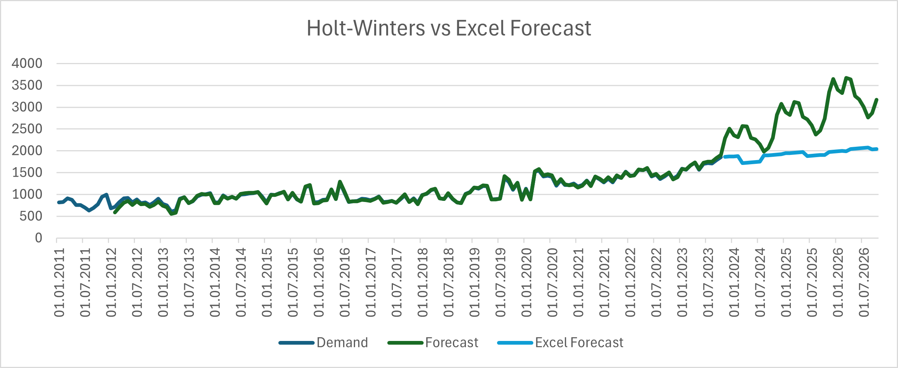
Prediction
Taking into account the seasonality of the data, within the framework of Excel, we were limited in tools. We tried to use the Holt-Winters method, but unfortunately, it did not provide reliable predictions.

Slide 20


Long-term Optimization - Mathematical Model
,
Subject to:
Where:
R – a set of Retailers – 335 total
D_{i} – demand of i-th Retailer
cDC – a set of current Distribution Centers – 6, in 6 Regions
pDC – a set of potential Distribution Centers – 10 locations
DC – a set of all Distribution Centers, union of cDC and pDC – 16 total
C_{j} – capacity of j-th Distribution Center
r_{j} – rent of j-th potential Distribution Center
x_{ij} - the binary variable such that x_{ij} = 1 iff i-th Retailer is supplied by j-th Distribution Center, and 0 otherwise
y_{j} – the binary variable such that y_{j} = 1 if j-th potential Distribution Center is to be rented
l_{ij} – the cost of supplying i-th Retailer from j-th Distribution Center, calculated in the same way as for short term optimization, however cost is estimated to rise to 1.25 EUR

Slide 21
New Location Choice
Rented Locations are among the cheapest offered; nevertheless, the more likely reason for choosing them is their location and the part it plays in cost minimization
Rent plays a relativelly small part in final cost – less than 14%

Slide 22
Long-term Retailer Reallocation
From Belgrade to Vojvodina: rb08
From Vojvodina to Belgrade: rv04, rv05, rv08, rv10, rv17, rv24, rv49, rv55, rv71, rv73, rv77, rv79, rv80
From Sumadija to Belgrade: rs13, rs47, rs49
From West to Belgrade: rw10, rw15, rw19, rw31, rw33, rw38, rw39, rw43, rw45, rw47, rw50
From Vojvodina to Sumadija: rv02, rv25, rv66
From Belgrade to Sumadija: rb25, rb29, rb41, rb50
From East to Sumadija: re11, re14, re15, re19, re20, re23, re27, re28, re30, re33, re36, re39, re47, re50, re51, re56
From Belgrade to West: rb02, rb03, rb06, rb18, rb19, rb31, rb35, rb39, rb49.
From Sumadija to West: rs12, rs14, rs18, rs20, rs25, rs27, rs31, rs34, rs37, rs39, rs42, rs50
From Sumadija to East: rs01 and rs33
From Kosovo to East: rk29
From East to Kosovo: re04, re09, re10, re38, re41, re54

